Slide 1
Python3 basics
Michele La Manna
Dept. of Information Engineering
University of Pisa
michele.lamanna@phd.unipi.it
Version: 2021-03-10

Slide 2
Python3

Slide 3
What is Python?
Python is an easy to learn, powerful programming language.
It has a simple but effective approach to object-oriented programming.
Python is an ideal language for scripting and rapid application development in many areas on most platforms.
Major Perks:
Easy to read;
Easy to learn;
Intuitive string manipulation;
Already installed on UNIX;
No semicolon (;) at the end of an instruction!
Major Cons:
Must indent code;
Slower than C/C++;
Beware of your python version!

Slide 4
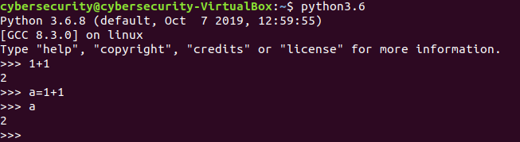
Python3.6
sudo apt-get install python3.6
You can use python directly from the terminal
Invoking python:
As you can see, you cannot specify the type of the variables for example:
int a=2;
Python automatically knows the type of the variable based on the assignment.

Slide 5
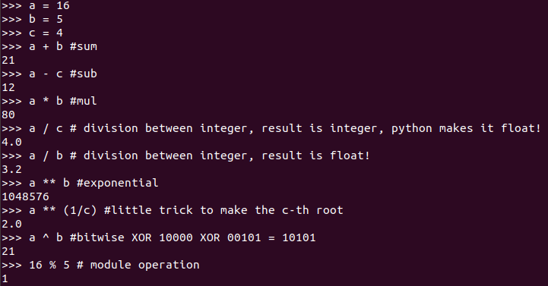
Basic math operations

Slide 6
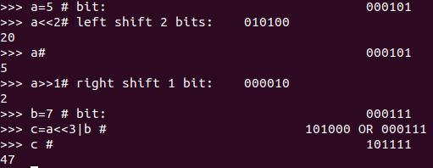
Basic math operations
You can also manipulate bits with right or left shifts.
Then, you can combine those bits in a single number!

Slide 7
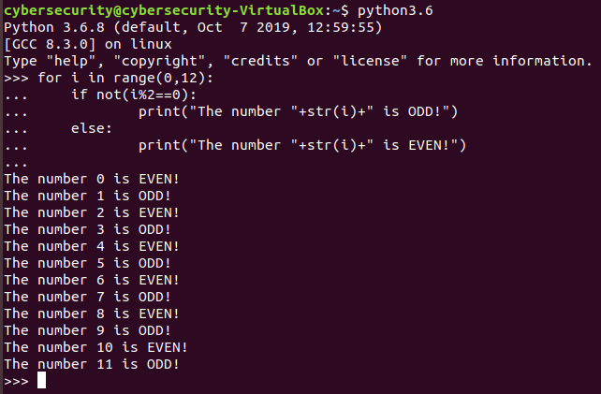
Loops and conditions
For loops and if statements do not need parenthesis.
However, you have to put a colon at the end of the statement.
Furthermore, remember to correctly indent your code!

Slide 8
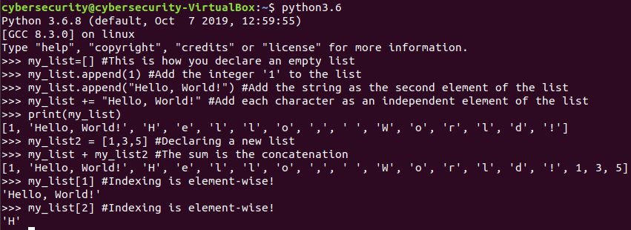
Lists
The most useful structure in python is the List.
Think of a List in python as an array in C++, but much more flexible! A List can contain elements of the same type, but also different elements!

Slide 9
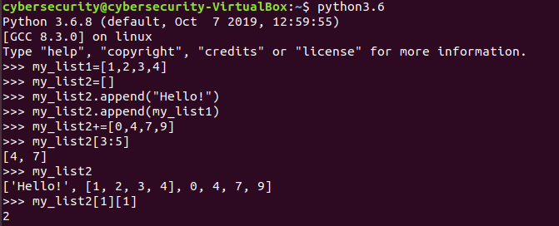
Lists
Lists can also be nested!

Slide 10
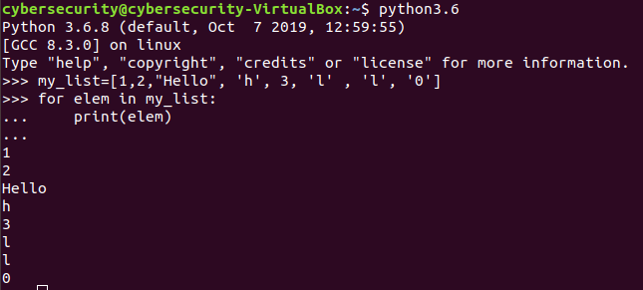
For and lists
Take a look!
This lines means
for (each element named) elem in(side the list named) my_list:
print(“elem”)
Elem is not an index, but it assumes the value of the elements inside the list!

Slide 11
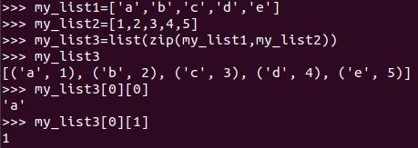
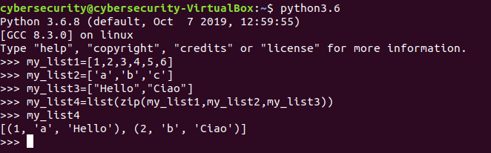
zip() command
Merges zero or more equal-length lists:
What if lists have different lengths?

Slide 12
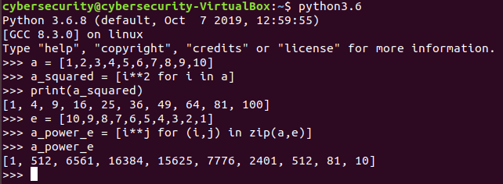
For, lists and zip
You can build lists using for loops also in a single line! Check out the example below (list comprehension):
Are you able to understand what’s going on?
Y

Slide 13
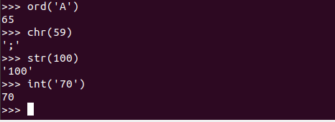
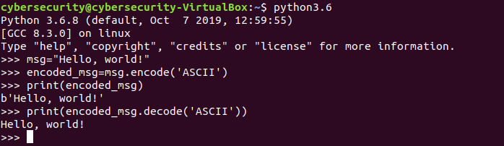
Conversion commands
ord(‘<char>’) converts a single character into its ASCII integer value,
chr(<int>) does the opposite.
For strings, use the functions encode(‘<format>’), decode(‘<format>’)

Slide 14
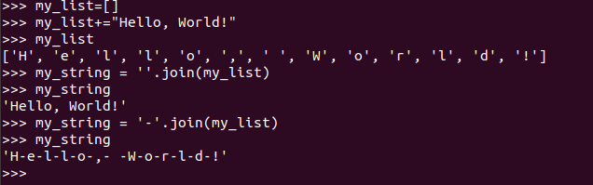
Join command
If you have a list of characters or strings, and want them to be a single string, use: ‘<glue>’.join(<list>)
The function “glues” every character of the list together through the parameter <glue>. Of course, you can put absolutely nothing as the <glue> parameter!

Slide 15
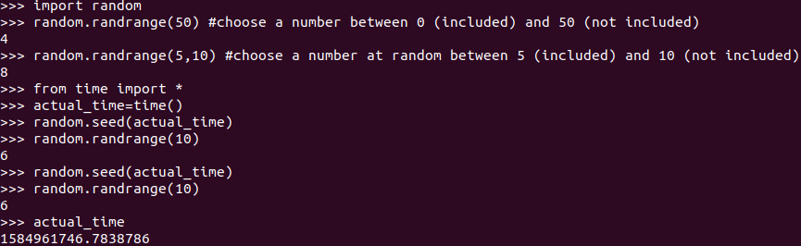
modules
Python has libraries, called modules, just like any other language!
Let’s see an example:
The module random lets you play with randomness.
One of the most useful command is randrange().
The function time.time() returns the number of seconds elapsed since epoch (For UNIX systems: 1 jan 1970)

Slide 16
Confused? Good!
Now it’s time to cement those concepts with some practice!
Download the archive, you will find 3 exercises:
Nuclear_threat/Easy
Nuclear_threat/Hard
evil_man
In each folder you will find:
A ciphertext file;
a code in python3 who lets you encrypt a message;
some instructions which give you a little context, just for fun!
Your objective is to analyze the python code so that you can write a script that decrypts the ciphertext. The message contains a string between two curly brackets, for example: {This_1s_A_dem0_5tr1ng}
We will give you hints every 10 to 20 minutes!
Good luck!

